Slide 1

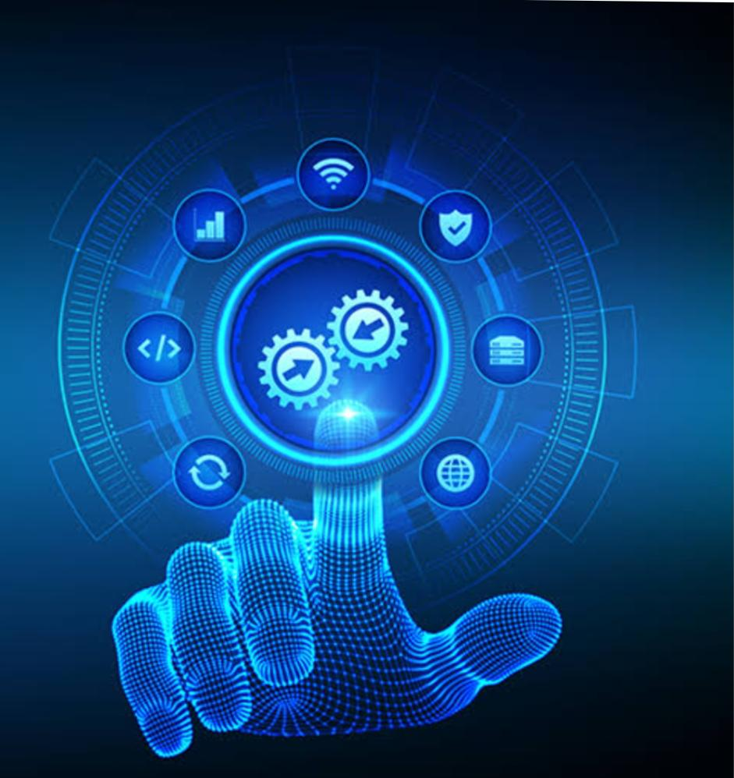
Project work
Topic : smart home security system using iot and embedded system
Project submitted by : M. ALAGU RAJATHI

Slide 2
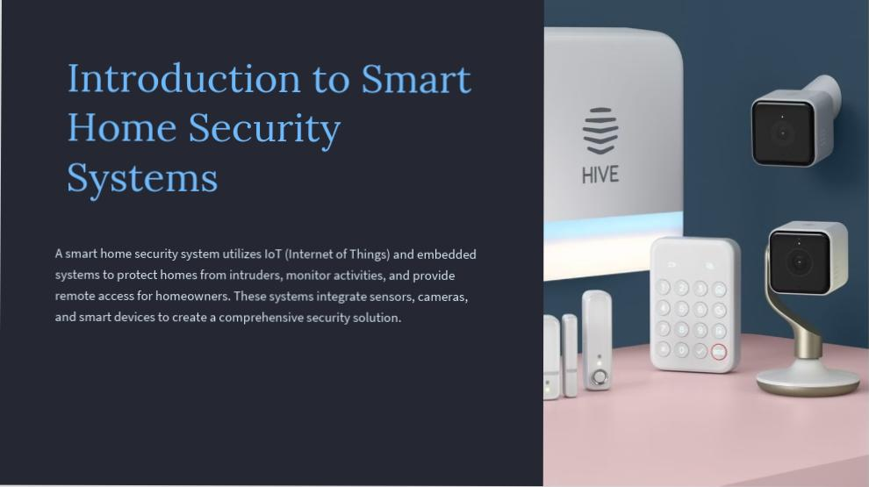

Slide 3
Overview of IoT (Internet of Things) and embedded systems
IoT (Internet of Things)
Embedded Systems
Integration in Smart Homes
Embedded systems are specialized computing systems designed to perform dedicated functions within larger mechanical or electrical systems.
IoT refers to the interconnection of everyday objects via the internet, enabling them to send and receive data.
Both IoT and embedded systems play crucial roles in creating a seamless and secure smart home environment.

Slide 4

Components of a smart home security system
Surveillance Cameras: High-definition cameras with motion detection and night vision capabilities for monitoring indoor and outdoor areas.
Smart Sensors: Door/window sensors, motion detectors, and glass break sensors to alert homeowners of any unauthorized entry or potential security breaches.
Smart Locks: Keyless entry systems with remote access and control, allowing users to lock and unlock doors from anywhere via a mobile app.

Slide 5
Importance of Security in a Smart Home
Protection of Property and Family
Deterrence of Intruders
Visible security measures, such as cameras and sensors, act as a deterrent to potential intruders, preventing break-ins.
Smart home security systems provide peace of mind by safeguarding property and ensuring the safety of family members.
Real-time Monitoring and Alerts
Data Privacy and Protection
Continuous monitoring and instant alerts enable quick response to potential threats, enhancing overall security.
Advanced encryption and secure communication protocols ensure the privacy and protection of sensitive data within the smart home system.

Slide 6
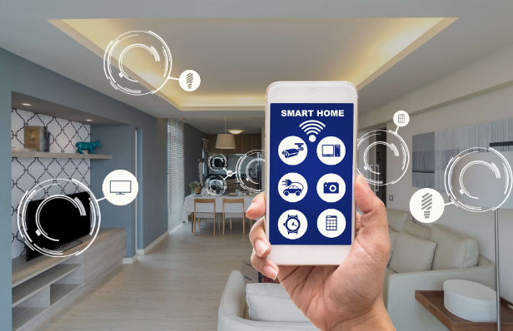
Integration of IoT and embedded systems in a security system
Smart home security systems integrate IoT (Internet of Things) and embedded systems to create a robust network of interconnected devices.
By seamlessly connecting sensors, cameras, and alarms, IoT ensures real-time monitoring and enhanced security measures.
IoT enables remote access and control of security devices.
Embedded systems process data locally for quick responses.

Slide 7



Benefits of a smart home security system
Peace of Mind
Convenience
24/7 Protection
Feel secure knowing your home is protected, giving you peace of mind.
Access and control your home security from anywhere for added convenience.
Continuous monitoring and immediate response to ensure round-the-clock protection.

Slide 8
Challenges and considerations in building a smart home security system
Privacy Concerns
Interoperability
User Awareness
Ensuring data privacy and protection from cyber threats is crucial in smart home security systems.
Integrating different IoT devices and systems, each with its communication protocol, can be complex.
Users need to understand the system's capabilities and limitations to ensure effective use.
Constant monitoring and regular updates are required to safeguard against potential security breaches.
Compatibility issues between devices and platforms need to be carefully addressed for seamless operation.
Proper training and clear instructions are essential for maximizing the system's potential.

Slide 9

Future Trends and Advancements in Smart Home Security Systems
1
AI & Machine Learning Integration
Advanced AI algorithms will analyze patterns to detect potential threats in real time.
2
Biometric Security Features
Biometric identification, such as fingerprint and facial recognition, will enhance access control.
3
Cloud-Based Monitoring and Storage
Cloud technology will offer secure storage and remote monitoring for smart home security systems.

Slide 10


IoT and Embedded Systems in Real Life Applications
Aside from smart home security systems, IoT and embedded systems are revolutionizing various real-life applications.
From healthcare to agriculture, these technologies enable remote monitoring, predictive maintenance, and efficient resource management.
Furthermore, smart cities utilize IoT and embedded systems to enhance public safety, transportation, and infrastructure. The potential for innovation is vast and diverse.

Slide 11
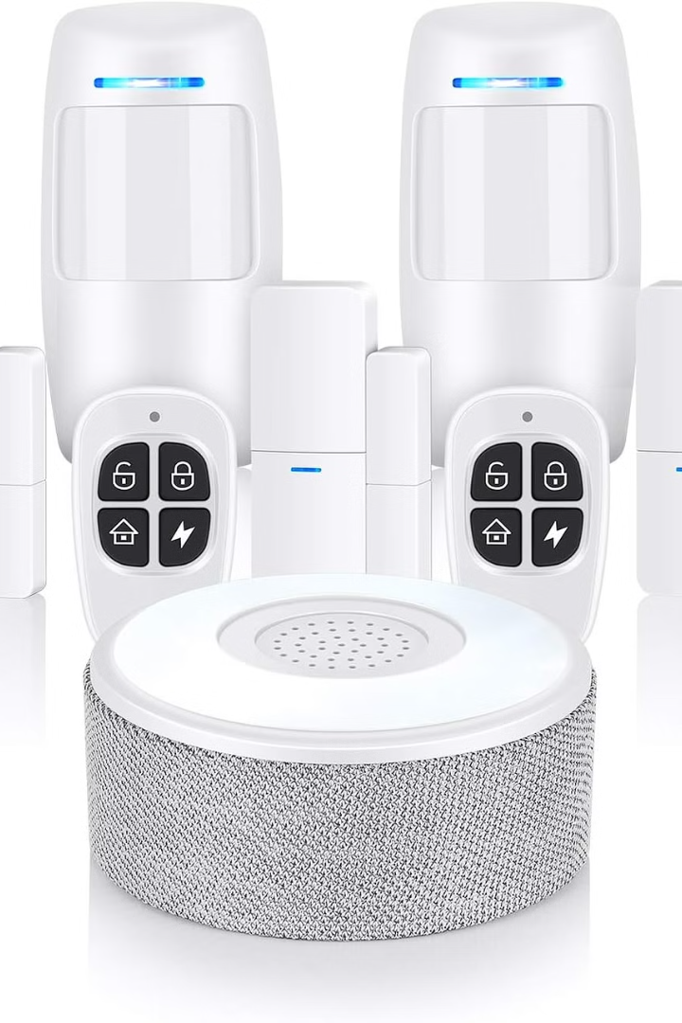
Building a Secure Future
Implementing a smart home security system using IoT and embedded systems offers peace of mind and advanced protection for your home. With real-time monitoring and automated responses, it ensures a secure environment for your loved ones and valuable assets.
Embracing this technology means embracing a future where security is seamless, proactive, and intelligently integrated into our daily lives.

Slide 12

Thank you upskill campus

